Slide 1
CS118 – Programming Fundamentals
Lecture # 24
Tuesday, November 20, 2019
FALL 2019
FAST – NUCES, Faisalabad Campus
Course Instructor:
Ebad Majeed
Slides Credit:
Rizwan Ul Haq

Slide 2

Two- and Multidimensional Arrays
Two-dimensional array: collection of a fixed number of components (of the same type) arranged in two dimensions
Sometimes called matrices or tables
Declaration syntax:
where intexp1 and intexp2 are expressions yielding positive integer values, and specify the number of rows and the number of columns, respectively, in the array

Slide 3
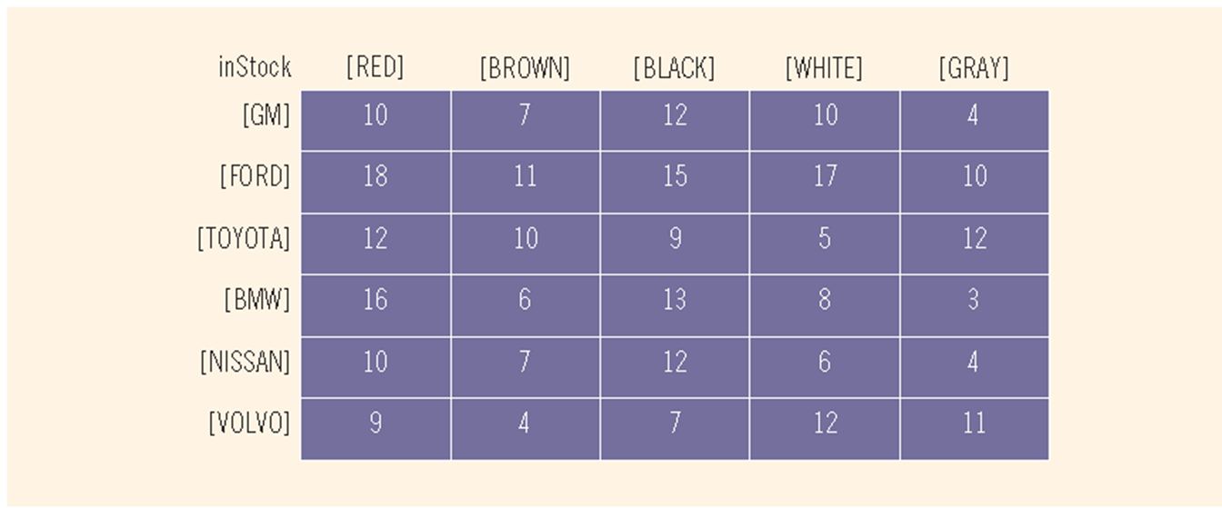
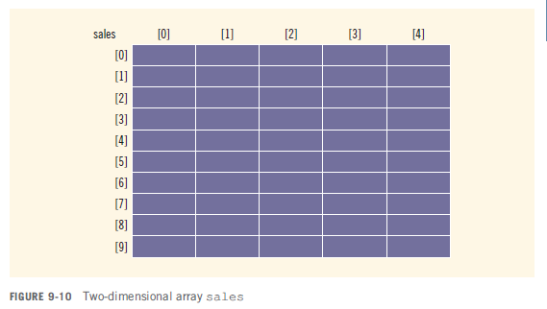
Two- and Multidimensional Arrays (cont'd.)

Slide 4

Accessing Array Components
Syntax:
where indexexp1 and indexexp2 are expressions yielding nonnegative integer values, and specify the row and column position

Slide 5
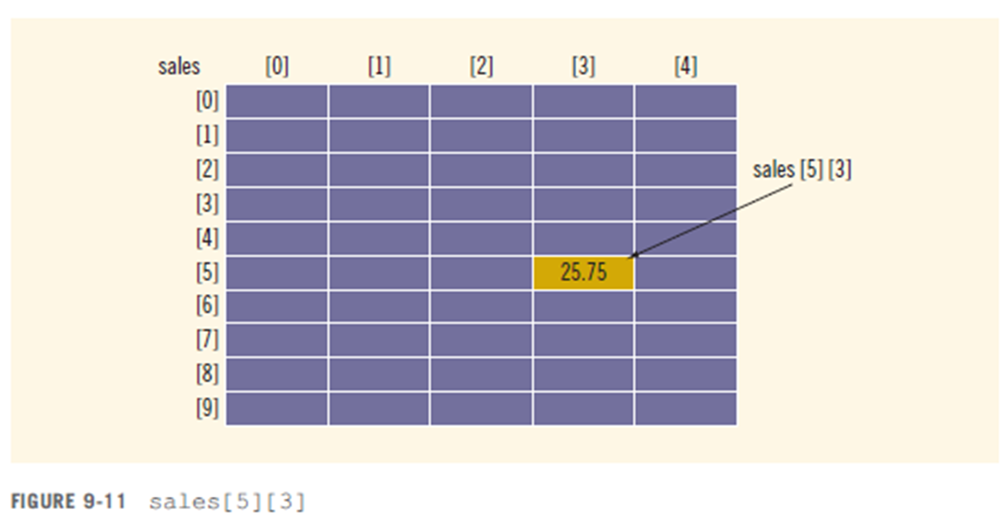
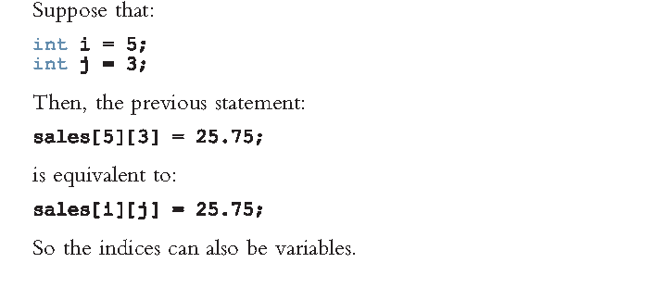
Accessing Array Components (cont'd.)

Slide 6
Two-Dimensional Array Initialization During Declaration
Two-dimensional arrays can be initialized when they are declared:
int board[4][3] = {{2, 3, 1},
{15, 25, 13},
{20, 4, 7},
{11, 18, 14}};
Elements of each row are enclosed within braces and separated by commas
All rows are enclosed within braces
For number arrays, if all components of a row aren’t specified, unspecified ones are set to 0

Slide 7
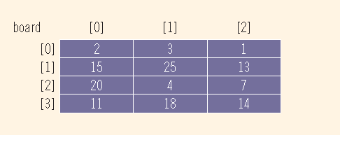
Example

Slide 8
Processing Two-Dimensional Arrays
Ways to process a two-dimensional array:
Process the entire array
Process a particular row of the array, called row processing
Process a particular column of the array, called column processing
Each row and each column of a two-dimensional array is a one-dimensional array
To process, use algorithms similar to processing one-dimensional arrays

Slide 9
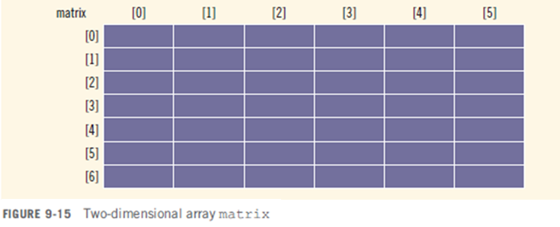
Processing Two-Dimensional Arrays (cont'd.)
const int NUMBER_OF_ROWS = 7;//This can be set to any number
const int NUMBER_OF_COLUMNS = 6;//This can be set to any number
int matrix[NUMBER_OF_ROWS][NUMBER_OF_COLUMNS];
int row;
int col;
int sum;
int largest;
int temp;
Figure 9-15 shows Two-dimensional array matrix

Slide 10
Initialization
const int NUMBER_OF_ROWS = 7;
const int NUMBER_OF_COLUMNS = 6;
int matrix[NUMBER_OF_ROWS][NUMBER_OF_COLUMNS];
int row;
int col;
int sum;
int largest;
int temp;
To initialize row number 5 (i.e., sixth row) to 0:
row = 5;
for(int col = 0 ; col < NUMBER_OF_COLUMNS ; col++)
matrix[row][col] = 0;
To initialize the entire matrix to 0:
for(row = 0 ; row < NUMBER_OF_ROWS ; row++)
for(col = 0 ; col < NUMBER_OF_COLUMNS ; col++)
matric[row][col] = 0 ;

Slide 11
Print
const int NUMBER_OF_ROWS = 7;
const int NUMBER_OF_COLUMNS = 6;
int matrix[NUMBER_OF_ROWS][NUMBER_OF_COLUMNS];
int row;
int col;
int sum;
int largest;
int temp;
To input data into each component of matrix:
for(row = 0 ; row < NUMBER_OF_ROWS ; row++)
{
for(col = 0 ; col < NUMBER_OF_COLUMNS ; col++)
cout << setw(5) << matrix[row][col] << “ ” ;
cout << endl;
}

Slide 12
Input
const int NUMBER_OF_ROWS = 7;
const int NUMBER_OF_COLUMNS = 6;
int matrix[NUMBER_OF_ROWS][NUMBER_OF_COLUMNS];
int row;
int col;
int sum;
int largest;
int temp;
To input data into each component of matrix:
for(row = 0 ; row < NUMBER_OF_ROWS ; row++)
for(col = 0 ; col < NUMBER_OF_COLUMNS ; col++)
cin >> matrix[row][col] ;

Slide 13
Sum by Row
const int NUMBER_OF_ROWS = 7;
const int NUMBER_OF_COLUMNS = 6;
int matrix[NUMBER_OF_ROWS][NUMBER_OF_COLUMNS];
int row;
int col;
int sum;
int largest;
int temp;
To find the sum of row number 3 of matrix:
sum = 0 ;
row = 3 ;
for(col = 0 ; col < NUMBER_OF_COLUMNS ; col++)
sum += matrix[row][col] ;
To find the sum of each individual row:
//Sum of each individual row
for (row = 0; row < NUMBER_OF_ROWS; row++)
{
sum = 0;
for (col = 0; col < NUMBER_OF_COLUMNSS; col++)
sum += matrix[row][col];
cout << “Sum of Row ” << row + 1
<< “ = ” << sum << endl;
}

Slide 14
Sum by Column
const int NUMBER_OF_ROWS = 7;
const int NUMBER_OF_COLUMNS = 6;
int matrix[NUMBER_OF_ROWS][NUMBER_OF_COLUMNS];
int row;
int col;
int sum;
int largest;
int temp;
To find the sum of each individual column:
//Sum of each individual column
for (col = 0 ; col < NUMBER_OF_COLUMNS ; col++)
{
sum = 0 ;
for(row = 0 ; row < NUMBER_OF_ROWS ; row++)
sum += matrix[row][col] ;
cout << “Sum of Column ” << col + 1
<< “ = ” << sum << endl ;
}

Slide 15
Sum of Matrix
const int NUMBER_OF_ROWS = 7;
const int NUMBER_OF_COLUMNS = 6;
int matrix[NUMBER_OF_ROWS][NUMBER_OF_COLUMNS];
int row;
int col;
int sum;
int largest;
int temp;
To find the sum of complete matrix:
//Sum of complete matrix
sum = 0 ;
for (row = 0 ; row < NUMBER_OF_ROWS ; row++)
{
for(col = 0 ; col < NUMBER_OF_COLUMNS ; col++)
sum += matrix[row][col] ;
}
cout << “Sum of Matrix = ” << sum << endl ;

Slide 16
Largest Element in Each Row
const int NUMBER_OF_ROWS = 7;
const int NUMBER_OF_COLUMNS = 6;
int matrix[NUMBER_OF_ROWS][NUMBER_OF_COLUMNS];
int row;
int col;
int sum;
int largest;
int temp;
//Largest number in each row
for (row = 0 ; row < NUMBER_OF_ROWS ; row++)
{
largest = matrix[row][0] ;
for(col = 1 ; col < NUMBER_OF_COLUMNS ; col++)
if(matrix[row][col] > largest)
largest = matrix[row][col];
cout << “The largest element in row ” << row + 1 << “ = ” << largest << endl;
}

Slide 17
Largest Element in Each Column
const int NUMBER_OF_ROWS = 7;
const int NUMBER_OF_COLUMNS = 6;
int matrix[NUMBER_OF_ROWS][NUMBER_OF_COLUMNS];
int row;
int col;
int sum;
int largest;
int temp;
//Largest number in each col
for (col = 0 ; col < NUMBER_OF_COLS ; col++)
{
largest = matrix[0][col] ;
for(row = 1 ; row < NUMBER_OF_ROWS ; row++)
if(matrix[row][col] > largest)
largest = matrix[row][col];
cout << “The largest element in col ” << col + 1 << “ = ” << largest << endl;
}

Slide 18
Largest Element in Matrix
const int NUMBER_OF_ROWS = 7;
const int NUMBER_OF_COLUMNS = 6;
int matrix[NUMBER_OF_ROWS][NUMBER_OF_COLUMNS];
int row;
int col;
int sum;
int largest;
int temp;
//Largest number in the matrix
largest = matrix[0][0] ;
for (row = 0 ; row < NUMBER_OF_ROWS ; row++) {
for(col = 0 ; col < NUMBER_OF_COLUMNS ; col++)
if(matrix[row][col] > largest)
largest = matrix[row][col] ;
}
cout << “The largest element in matrix = ”
<< largest << endl;

Slide 19
Passing Two-Dimensional Arrays as Parameters to Functions
Two-dimensional arrays can be passed as parameters to a function
Pass by reference
Base address (address of first component of the actual parameter) is passed to formal parameter
Two-dimensional arrays are stored in row order
When declaring a two-dimensional array as a formal parameter, can omit size of first dimension, but not the second

Slide 20
Example
Suppose we have following declaration:
const int NUMBER_OF_ROWS = 6;
const int NUMBER_OF_COLUMNS = 5;
Consider the following definition of function printMatrix:
void printMatrix(int matrix[][NUMBER_OF_COLUMNS], int noOfRows)
{
int row = 0, col = 0;
for( row = 0 ; row < noOfRows ; row++)
{
for(col = 0 ; col < NUMBER_OF_COLUMNS ; col++)
cout << setw(5) << matrix[row][col] << “ ” ;
cout << endl ;
}
}

Slide 21
Function outputs the sum of the elements of each row
void sumRows(int matrix[][NUMBER_OF_COLUMNS], int noOfRows)
{
int row, col, sum = 0 ;
for( row = 0 ; row < noOfRows ; row++)
{
sum = 0;
for(col = 0 ; col < NUMBER_OF_COLUMNS ; col++)
sum = sum + matrix[row][col] << “ ” ;
cout << “Sum of row ” << row + 1
<< “ = ” << sum << endl ;
}
}

Slide 22
Function determines the largest element in each row:
void largestInRows(int matrix[][NUMBER_OF_COLUMNS],
int noOfRows)
{
int row, col, sum = 0 ;
//Largest element in each row
for( row = 0 ; row < noOfRows ; row++)
{
largest = matrix[row][0];
for(col = 0 ; col < NUMBER_OF_COLUMNS ; col++)
if(matrix[row][col] > largest)
largest = matrix[row][col];
cout << “The Largest element of row ”
<< row + 1 << “ = ” << largest << endl ;
}
}

Slide 23
Array Arithmetic
If base address of the array is known the address of any index in the two dimensional array can be calculated.
Address of arr[row][col] provided base address of the array is ‘b’ and size of data type is ‘s’ and columns per row are COLS
Address of arr[row][col] = b + (row * COLS + col )* s
Or arr[row][col] = b + (row * COLS * s + col * s
e.g. for int Arr[5][6]; provided base address is 100
Address of Arr[1][2] = 100 + (1*6 + 2) * 4 = 100 + 32 = 132
Address of Arr[0][0] = 100 + (0*6 + 0) * 4 = 100 + 0 = 100
Address of Arr[4][0] = 100 + (4*6 + 0) * 4 = 100 + 96 = 196

Slide 24
Arrays of Strings
Strings in C++ can be manipulated using either the data type string or character arrays (C-strings)
On some compilers, the data type string may not be available in Standard C++ (i.e., non-ANSI/ISO Standard C++)

Slide 25
Arrays of Strings and the string Type
To declare an array of 100 components of type string:
string list[100];
Basic operations, such as assignment, comparison, and input/output, can be performed on values of the string type
The data in list can be processed just like any one-dimensional array

Slide 26
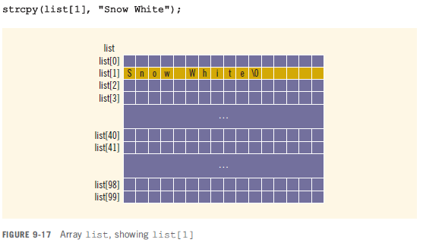
Arrays of Strings and C-Strings (Character Arrays)
Consider declaration
char list[100][16];
Now list[j] for each j, 0 <= j <= 99, is a string of at-most 15 characters in length

Slide 27
Contd..
Suppose that you want to read and store data in a list and there is one entry per line.
The following code accomplishes this:
char list[100][16];
for (int i = 0; i < 100; i++)
{
cin.get(list[i], 16);
cin.ignore();
}
The following for loop outputs the string in each row:
for (int i = 0; i < 100; i++)
cout << list[i] << endl;
You can also use other string functions (such as strcmp and strlen) and for loops to manipulate list

Slide 28
Questions

